Slide 1

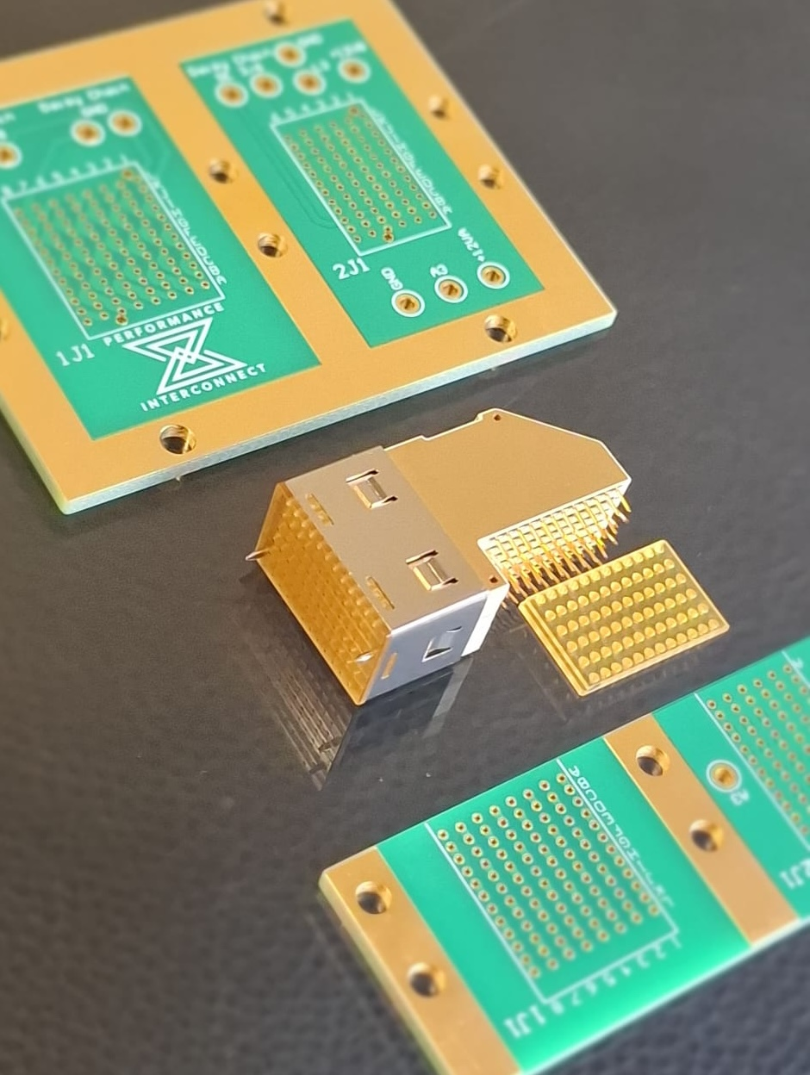





SPCD 2026 · ESA/ESTEC, NOORDWIJK · 13–16 OCTOBER 2026
HYPERBITS™ Single-Body High-Speed Connector with S‑FECT™ Solderless Terminations for ADHA Embedded Space Systems
Progress from Concept to Development to Validation
Gaby Cristian Mindreci
PERFORMANCE INTERCONNECT SAS
Olivier Perrotin
Alter Technology France
Supported by ESA (ARTES AT 5C.461) and CNES
Notes:
Welcome. Twenty minutes: what HYPERBITS is, how S-FECT works, what we have validated so far, and a short independent summary from Olivier Perrotin of Alter Technology.

Slide 2
OUTLINE
From concept to development to validation
01
02
03
04
Concept
Development
Validation
Independent view
Why ADHA needs a new backplane connector
What HYPERBITS™ is
How S‑FECT™ terminations work
How the connector is made
What makes it different
Power-plane configuration
Daughtercard-to-backplane resistance
Mechanical tests completed
High-data-rate (HDR) S-parameters vs requirement
Alter Technology France summary
Presented by Olivier Perrotin
Conclusions and next steps
SPCD 2026 · HYPERBITS™ · Performance Interconnect SAS
2
Notes:
Four parts. Olivier will take the fourth block for about four minutes.

Slide 3
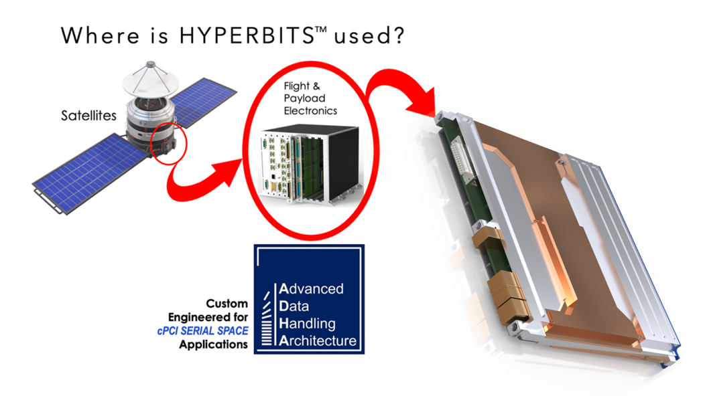
CONCEPT
ADHA pushes density, data rate and power beyond today’s multi-part press-fit connectors
What ADHA systems demand
Limits of press-fit HDR connectors
Higher interconnect density per slot
Multi-Gb/s serial links on the backplane
Power delivery through the same interface
Guaranteed reliability in severe launch and orbit environments
Multi-part stacks and separate wafers
Special insertion tooling and process
PCB pad and barrel deformation
Difficult removal and rework
Added cost and risk for European integrators
ESA ARTES AT 5C.461
Alter Technology France (prime) · Performance Interconnect (sub) · CNES support · contract signed 12 Dec 2023
Goal: a European, sovereign high-performance alternative for ADHA backplanes.
SPCD 2026 · HYPERBITS™ · Performance Interconnect SAS
3
Notes:
Problem statement from the abstract. Press-fit needs tooling, deforms pads and complicates rework. ESA ARTES AT 5C.461 funds the European alternative, with Alter as prime and CNES support.

Slide 4
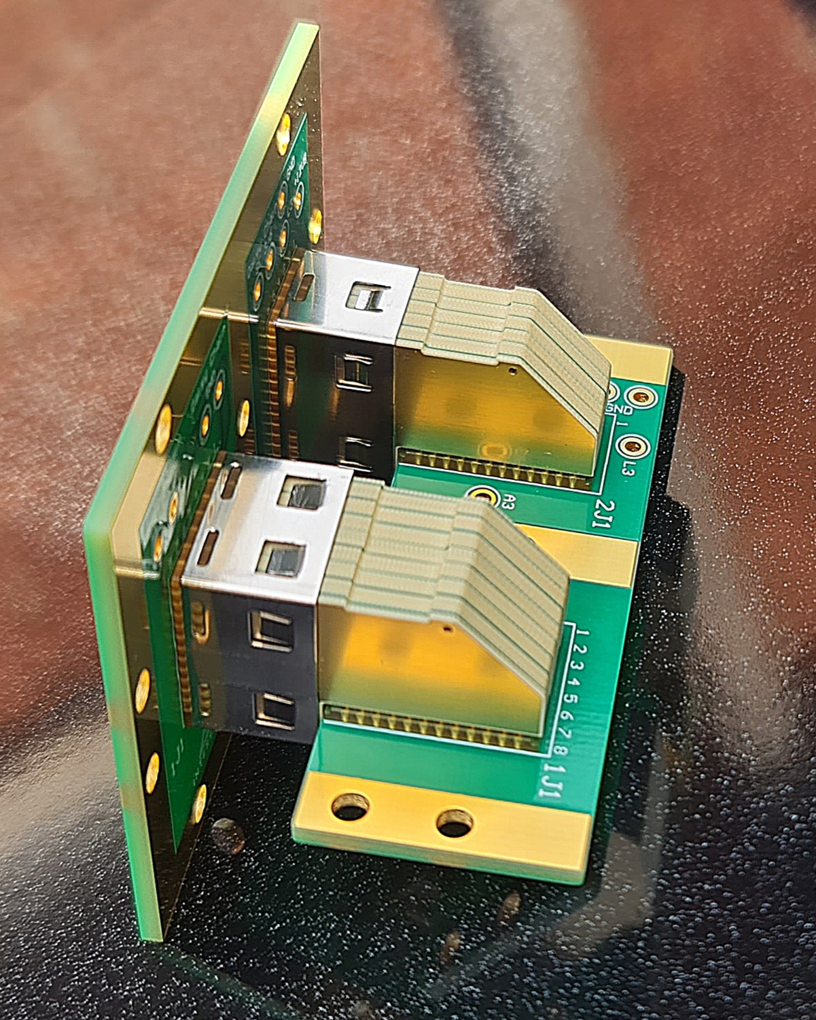
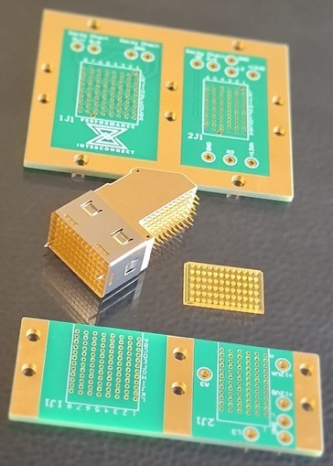
CONCEPT
HYPERBITS™: one body that mounts tool-less on the daughter card and blind-mates to the backplane
Single body
No separate wafers or multi-part stack
Signal architecture
Derived from CompactPCI Serial Space
Termination
S‑FECT™ solderless pins instead of press-fit
Mounting
Tool-less on the daughter card; blind-mating to the backplane
Footprint
Compatible with existing press-fit patterns
Variants tested
HDR 8-row signal and 6-row power, 12 positions (A–L)
SPCD 2026 · HYPERBITS™ · Performance Interconnect SAS
4
Notes:
Single-body, blind-mating connector. Same footprint as press-fit, so existing board layouts can be reused.

Slide 5
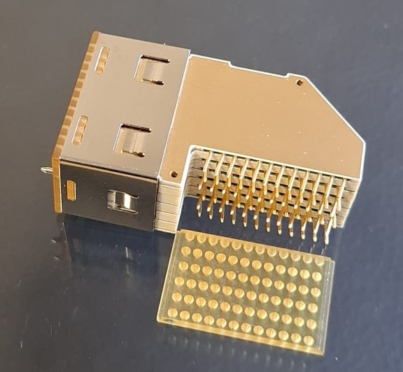
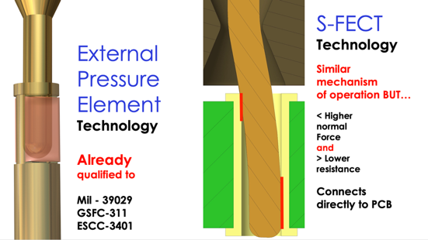
CONCEPT · HOW IT WORKS
S‑FECT™: a slide-fit contact that presses directly into the plated hole
S‑FECT = Slide-Fit Electrical Contact Termination
Mechanism akin to contacts qualified to MIL-DTL-39029, GSFC-311 and ESCC-3401
Higher normal force, lower and stable contact resistance
Zero pad deformation, zero loose particles
PCB and connector both reusable
International patent pending (GEN2 interface priority 01/09/2024)
Slide-fit pin engages the plated through-hole
Same principle as qualified external-pressure contacts
SPCD 2026 · HYPERBITS™ · Performance Interconnect SAS
5
Notes:
Explain the slide-fit action: the pin slides into the plated hole and holds by a high, controlled normal force, without cold-welding or deforming the barrel.

Slide 6
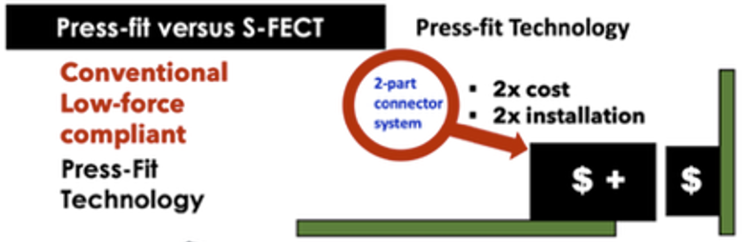
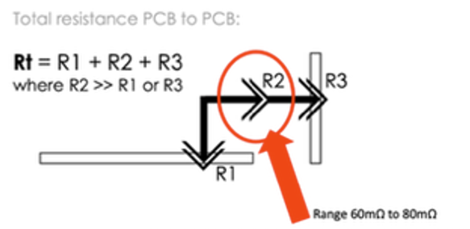
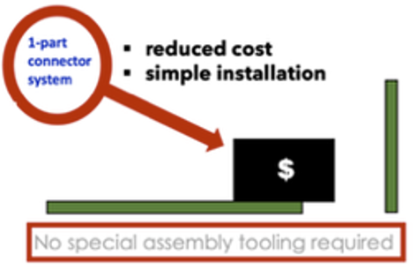
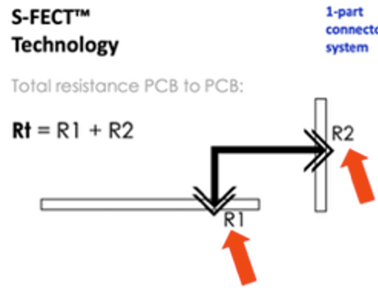
CONCEPT · WHAT MAKES IT SPECIAL
Removing the separable interface removes the dominant resistance term
Two-part press-fit system
HYPERBITS™ single body with S‑FECT™
Rt = R1 + R2 + R3
Rt = R1 + R2
R1, R3: press-fit terminations
R2: separable mating interface, 60–80 mΩ range — kept high because mating force must be limited at high contact count
R1 = R2 ≤ 5 mΩ
Only the two S‑FECT terminations remain: daughter card and backplane. No separable contact interface in the path.
Advantages compared with press-fit
Zero special tools
Zero jet effect
Zero pad deformation
Zero loose particles
Zero inspection
Same footprint
SPCD 2026 · HYPERBITS™ · Performance Interconnect SAS
6
Notes:
This is the core of the low resistance story. Press-fit two-part systems have three resistances in series and the separable interface dominates. HYPERBITS keeps only two S-FECT terminations.

Slide 7
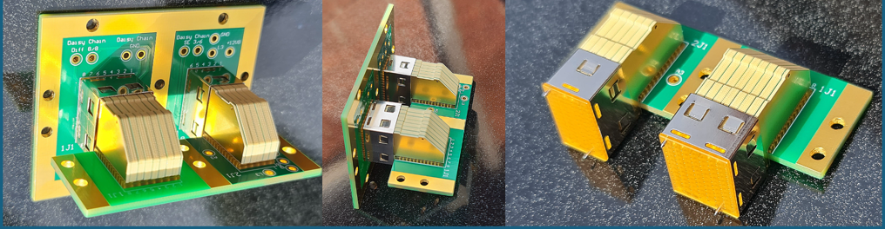
DEVELOPMENT
How the connector is made: stacked internal PCBs, S‑FECT™ pins and a transition plate
One single body
Internal PCB wafers
S‑FECT™ pins, both ends
Alignment / transition plate
Holds all wafers; integral blind-mate guidance
One per vertical row; controlled-impedance routing through the right angle
Terminates on the daughter card and on the backplane
Guides pins into the backplane holes during blind-mating
HDR and power prototypes on daisy-chain test boards (ARTES AT 5C.461)
SPCD 2026 · HYPERBITS™ · Performance Interconnect SAS
7
Notes:
Walk through the photos: left, the daisy-chain test board with two connectors; centre, side view of the right angle; right, the S-FECT pins and the mating face.

Slide 8
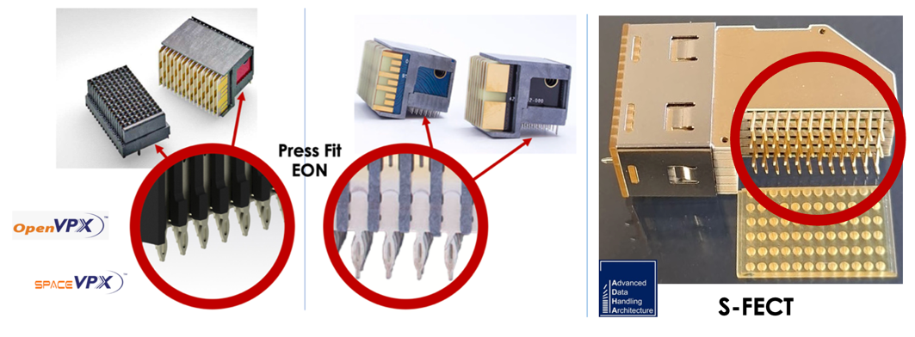
DEVELOPMENT · WHAT MAKES IT SPECIAL
Against existing VPX-class HDR connectors: one part, one termination type, no tooling
 | MULTIGIG RT 3 / R-VPX | HYPERBITS™
Parts per interface | Two-part connector system | Single body
PCB termination | Press-fit (EON) | S‑FECT™ slide-fit
Assembly tooling | Special press tooling | None
Rework | Difficult; pads deform | Reusable PCB and connector
PCB-to-PCB path | R1 + R2 + R3 | R1 + R2
SPCD 2026 · HYPERBITS™ · Performance Interconnect SAS
8
Notes:
Same density class as VPX connectors, but one part, one termination type and no press tooling.

Slide 9
VALIDATION
Most of the validation campaign is complete; data-monitored S&V was re-planned after a requirement update
Completed
In progress
DONE
DC contact and daisy-chain resistance
Vibration and shock with live data transfer
HDR 8-row and power 6-row
DONE
Insulation resistance and voltage proof
HDR: 200 MHz clock pattern across the differential daisy-chain, sampled at 6.4 Gb/s
Power: two daisy-chains monitored for contact disturbance ≥ 5 ns
Re-planned in the September 2026 schedule after the requirement change
500 Vdc IR, 750 Vrms DWV
DONE
Mating / unmating force
4 parts, cycles 1 and 4
DONE
HDR S-parameters, de-embedded
IL, RL, NEXT, FEXT, TDR · 5 samples + AirMax reference
DONE
Sine vibration and shock, 3 axes
Remaining ESA reliability sub-groups run to the same updated plan.
MECANO ID for Alter, 25/08/2025
SPCD 2026 · HYPERBITS™ · Performance Interconnect SAS
9
Notes:
Be explicit: the mechanical levels have been applied and passed; what remains is running them again while data is transferring, which the new requirement asks for.

Slide 10
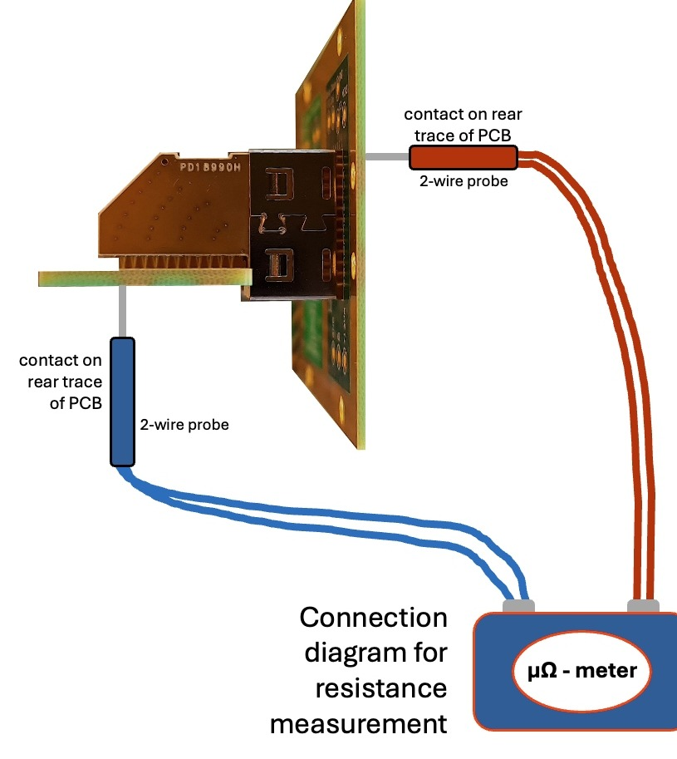
VALIDATION · RESISTANCE
Daughtercard-to-backplane resistance: 10–31 mΩ across all 96 HDR positions
 | 1 | 2 | 3 | 4 | 5 | 6 | 7 | 8
A | 19 | 12 | 20 | 11 | 18 | 12 | 17 | 12
B | 18 | 19 | 20 | 18 | 21 | 19 | 21 | 18
C | 10 | 21 | 14 | 19 | 12 | 19 | 12 | 20
D | 22 | 11 | 21 | 12 | 21 | 13 | 17 | 15
E | 22 | 22 | 22 | 20 | 22 | 22 | 20 | 21
F | 13 | 24 | 13 | 23 | 13 | 22 | 11 | 22
G | 22 | 11 | 21 | 12 | 23 | 10 | 20 | 11
H | 24 | 25 | 23 | 21 | 25 | 27 | 25 | 24
I | 10 | 27 | 14 | 25 | 14 | 30 | 11 | 26
J | 26 | 16 | 26 | 17 | 26 | 10 | 26 | 13
K | 26 | 30 | 26 | 30 | 24 | 25 | 24 | 27
L | 10 | 30 | 14 | 26 | 11 | 30 | 11 | 31
19.4 mΩ
mean, 96 positions
20 mΩ
median
31 mΩ
worst position
compared to
60–80 mΩ !!!
Rear PCB pad to rear PCB pad, 2-wire probes, µΩ-meter
press-fit mating interface alone (R2)
The complete card-to-backplane path is lower than the mating interface of a two-part press-fit system.
Columns = vertical rows 1–8 · Lines = positions A–L · values in mΩ
SPCD 2026 · HYPERBITS™ · Performance Interconnect SAS
10
Notes:
This is the key DC result. Every position, the whole path from the rear of the daughtercard pad to the rear of the backplane pad, sits between 10 and 31 milliohm, mean about 19. Compare with 60 to 80 milliohm for the mating interface alone in a two-part press-fit system.

Slide 11
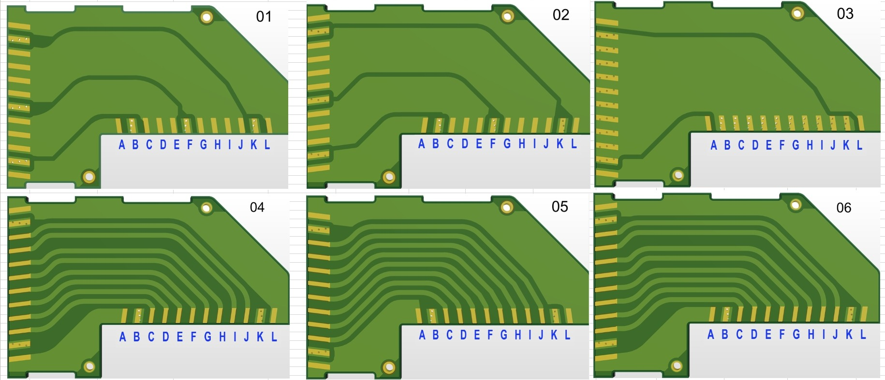
DEVELOPMENT · POWER CONNECTOR
Power connector: same-net contacts are tied by internal copper planes to cut resistance further
 | A | B | C | D | E | F | G | H | I | J | K | L
06 | +28VA | GND | CAN_A+ | CAN_A- | #PSON_In_A | #RST_In | SYNC_1_A/B+ | SYNC_1_AB- | SYNC_2_A/B+ | SYNC_2_A/B- | GND | +28VB
05 | +28VA | GND | Mon_AD_0 | Mon_AD_1 | Mon_Out_A | Mon_Out_B | I²C_A_SCL | I²C_A_SDA | I²C_B_SCL | I²C_B_SDA | GND | +28VB
04 | GND | GND | CAN_B+ | CAN_B- | #PSON_In_B | Reserved | SYNC_1_B/A+ | SYNC_1_B/A- | SYNC_2_B/A+ | SYNC_2_B/A- | GND | GND
03 | +5VA STBY | GND | GND | GND | GND | GND | GND | GND | GND | GND | GND | +5VB STBY
02 | +5VA STBY | GND | +12VA | +12VA | +12VA | GND | +12VB | +12VB | +12VB | +12VB | GND | +5VB STBY
01 | +5VA STBY | GND | +12VA | +12VA | +12VA | GND | +12VB | +12VB | +12VB | +12VB | GND | +5VB STBY
Power rail
Ground
Control / sync / I²C
H1 SYSTEM / Peripheral pinout, internal wafers 01–06
Why the resistance drops
Wafers 01–03 carry the rails: +12VA (C–E), +12VB (G–J), +5V standby and GND joined by wide copper planes
Contacts on one plane share current in parallel: path resistance falls roughly as R/N
Power planes start from about 6 mΩ per line
Wafers 04–06 route individual CAN, I²C, SYNC and monitor lines
SPCD 2026 · HYPERBITS™ · Performance Interconnect SAS
11
Notes:
Bottom three wafers are power. Instead of one trace per pin, same-net pins are joined by wide planes inside the connector, so the current divides across many S-FECT contacts in parallel. That is how the power connector gets below the single-contact value.

Slide 12
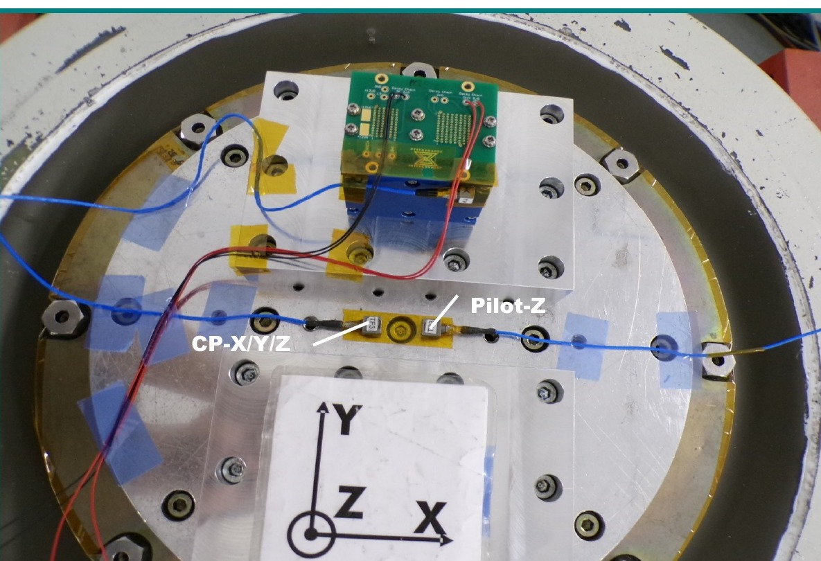
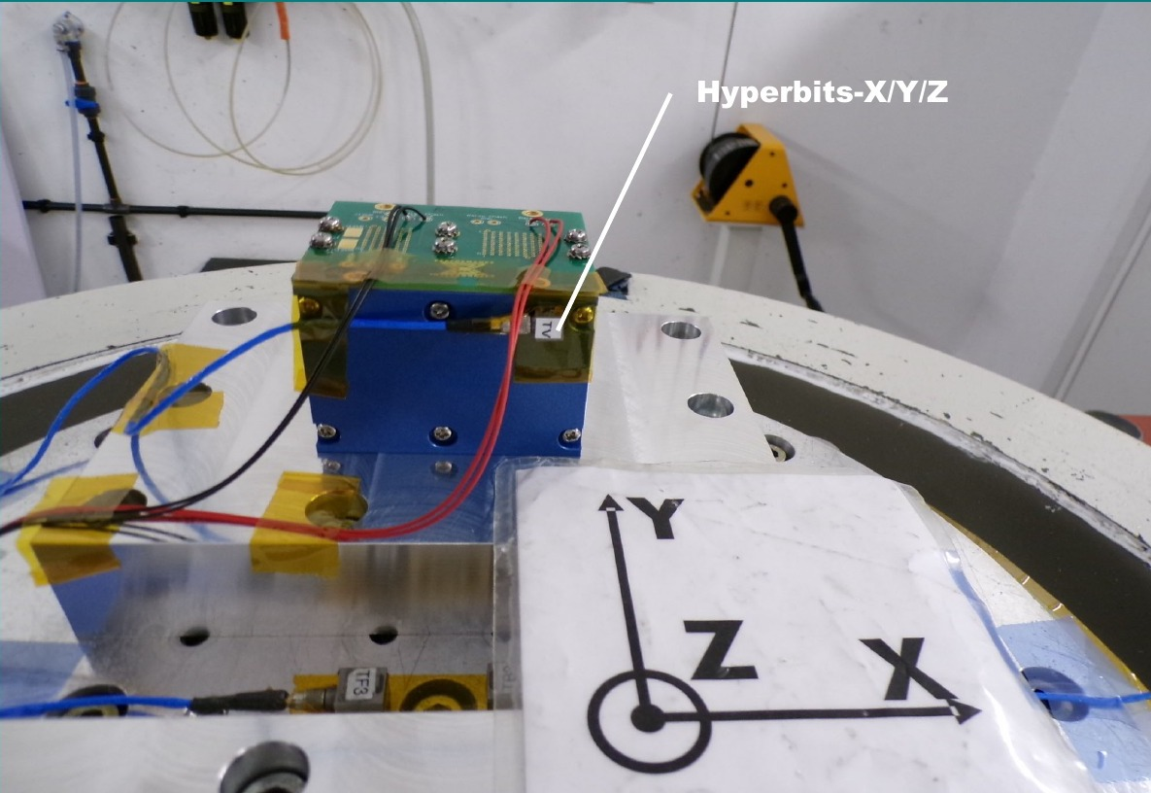
VALIDATION · MECHANICAL
Sine vibration and shock applied on three axes with no special event; mating forces stable
HDR 8-row mating / unmating force on daughter card (N)
Test jig on the LDS shaker, Z axis (MECANO ID for Alter Technology France)
Test | Level | Axes
Sine | 1.5 mm peak 10–57.6 Hz; 20 g 57.6–2000 Hz; 1 sweep up/down, 30 min | Z, X, Y
Shock | Half-sine 50 g, 11 ms; 3 shocks per direction | X, Y, Z
Report MID-HIX-S0J-PVE-001: “No special event occurred during these tests that have been performed in compliance with the specified levels.”
SPCD 2026 · HYPERBITS™ · Performance Interconnect SAS
12
Notes:
Shaker photos from the MECANO ID report done for Alter. Sine to 20 g up to 2 kHz and 50 g half-sine shock on all three axes, no event. Mating forces stay between about 100 and 140 N and do not drift between cycle 1 and cycle 4.

Slide 13
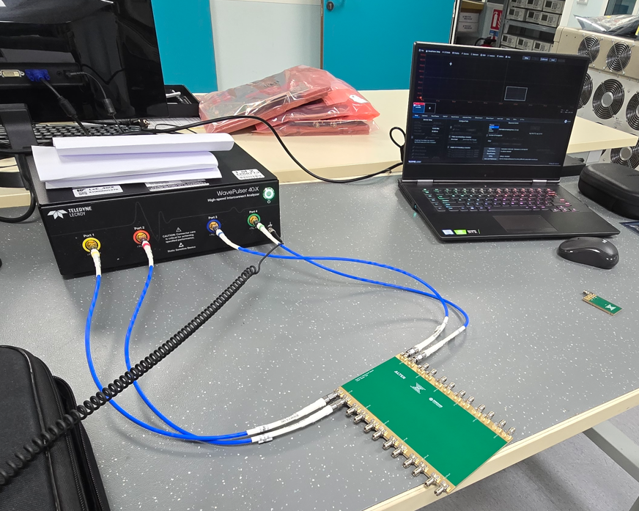
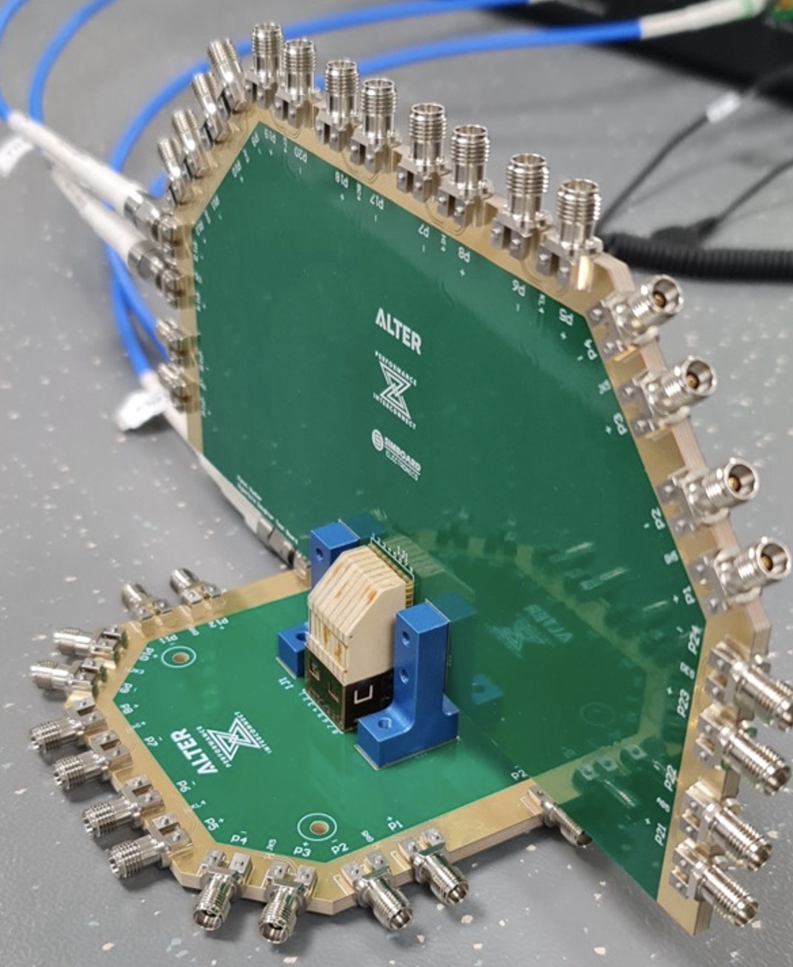
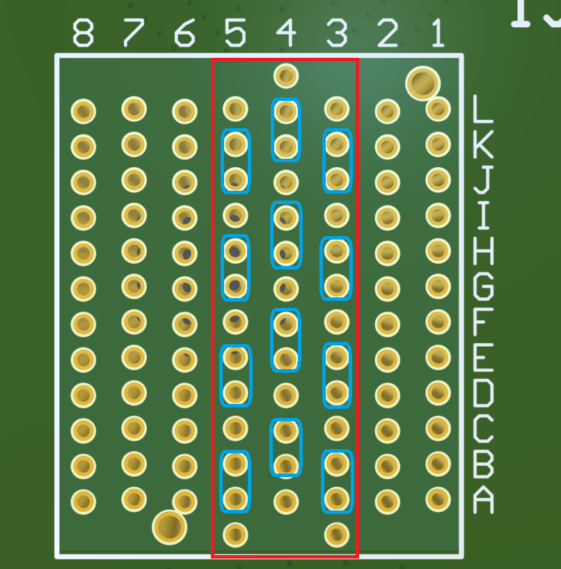
VALIDATION · HIGH DATA RATE
S-parameters measured SMA-to-SMA and de-embedded to the connector
Teledyne LeCroy WavePulser 40iX, MAUI 10.4.0.3
Calibration board removes the test cards: result = connector + breakout + ≈2 mm of trace each side
Rows 3, 4, 5 on SN14; five samples SN14–SN19
AirMax measured on the same test-card and calibration designs
Measured pairs: rows 3, 4, 5
Calibration board on the WavePulser 40iX
Data: HYPERBITS™ Measurement Report V5
Daughter and backplane test boards
SPCD 2026 · HYPERBITS™ · Performance Interconnect SAS
13
Notes:
Measurement method. Because the breakout and 2 mm of trace remain in the result, crosstalk numbers are conservative.

Slide 14
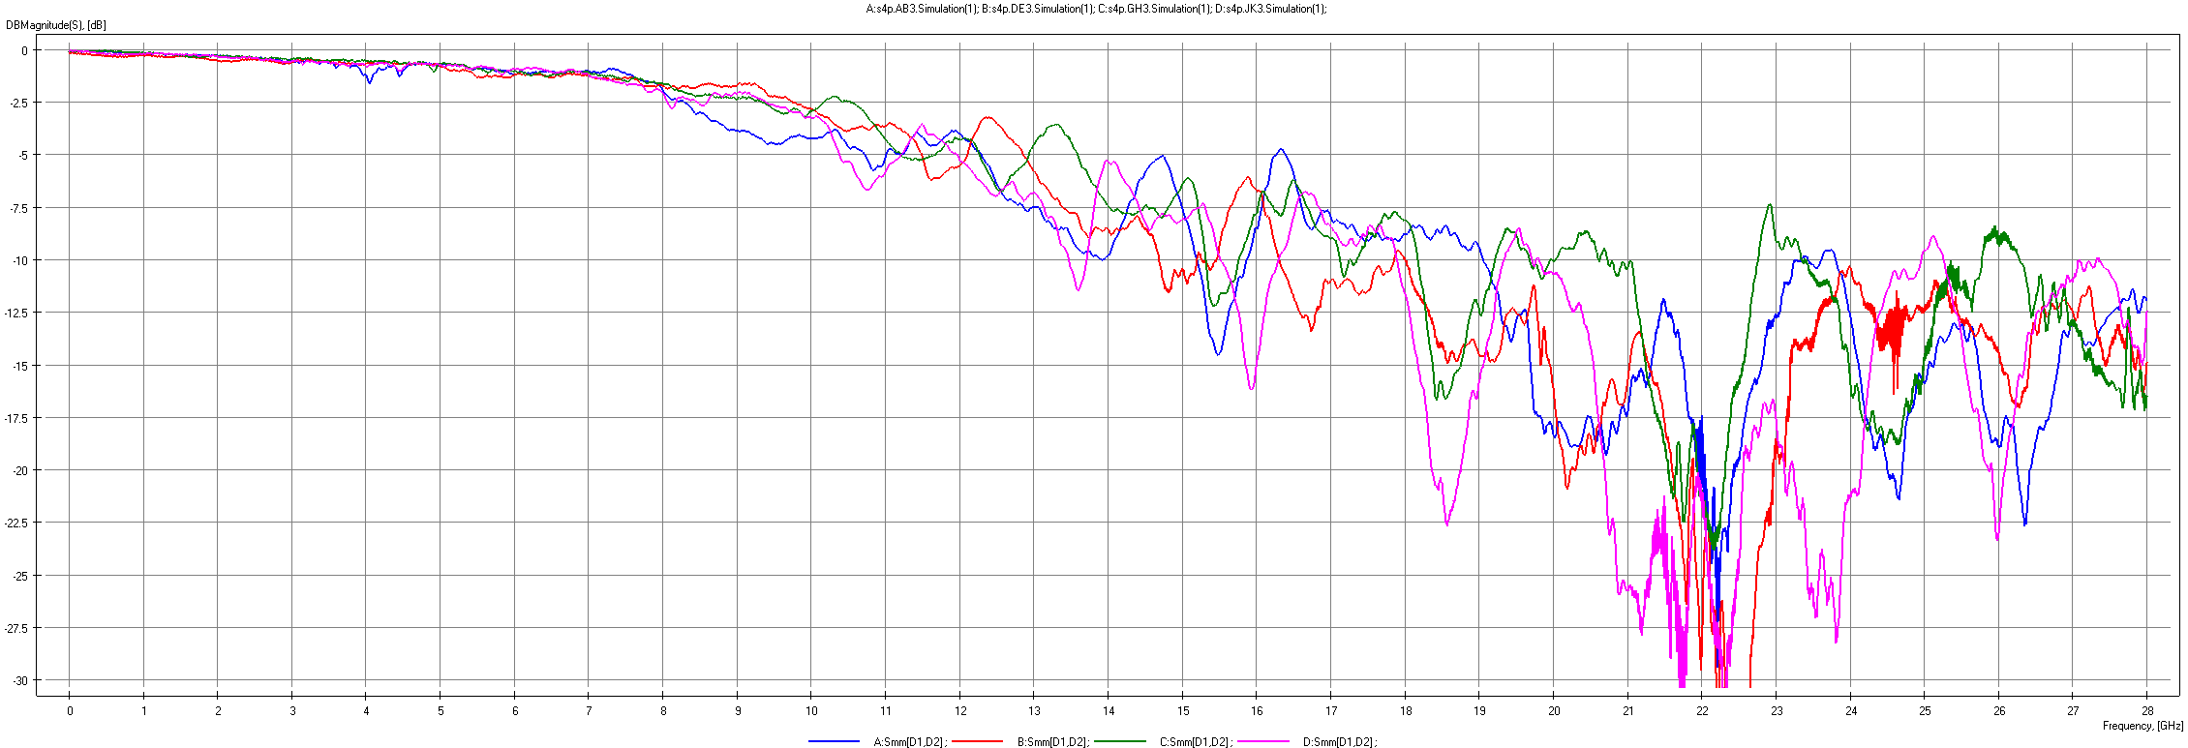
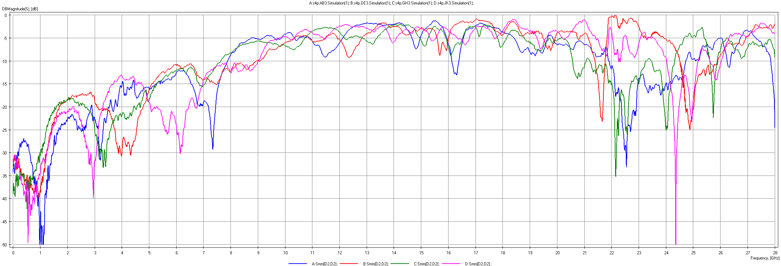
VALIDATION · HIGH DATA RATE
Row-to-row: insertion and return loss for rows 3, 4 and 5 are near-identical
What the curves show
IL within –1.2 dB up to 6.25 GHz on every pair
Rows 3, 4 and 5 overlay closely: the field structure is consistent through the stack
No “bad row” stands out
Insertion loss, row 3 pairs AB3, DE3, GH3, JK3 (dB vs GHz, 0–28 GHz)
Lower plot: return loss, row 3
SPCD 2026 · HYPERBITS™ · Performance Interconnect SAS
14
Notes:
Rows 4 and 5 look the same as row 3 in the report, so one row is shown.

Slide 15
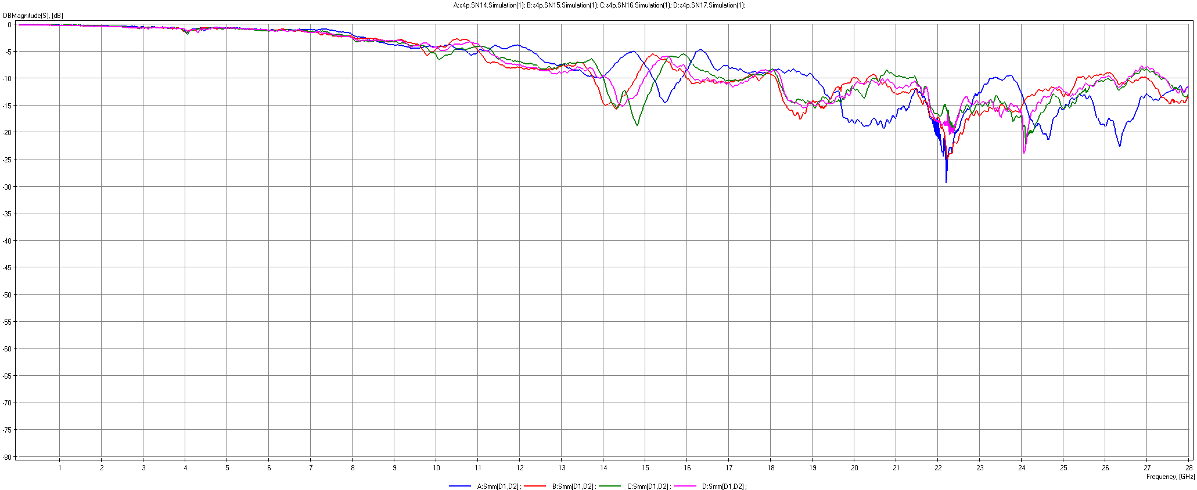
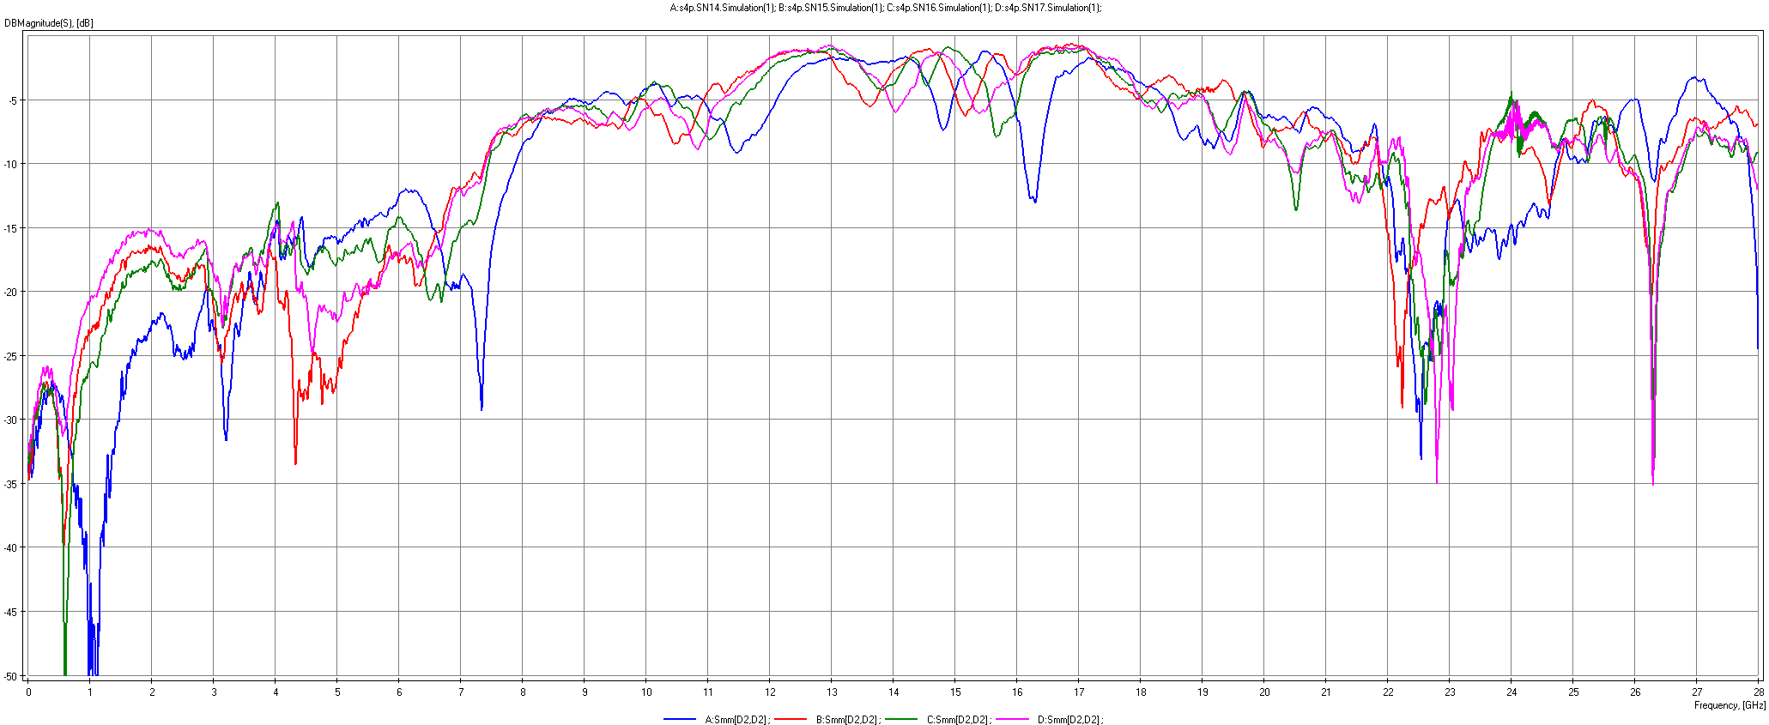
VALIDATION · HIGH DATA RATE
Unit-to-unit: five connectors sit almost on top of each other in insertion loss
Insertion loss AB3, SN14 / SN15 / SN16 / SN17
Return loss AB3, same samples
5
8
Small
samples measured (SN14–SN19)
pairs compared unit-to-unit
RL/TDR shifts: PCB impedance tolerance, not mechanics
SPCD 2026 · HYPERBITS™ · Performance Interconnect SAS
15
Notes:
Sample spread is small. The visible RL differences point to the connector PCB impedance tolerance and plating geometry, not to gross mechanical variation.

Slide 16
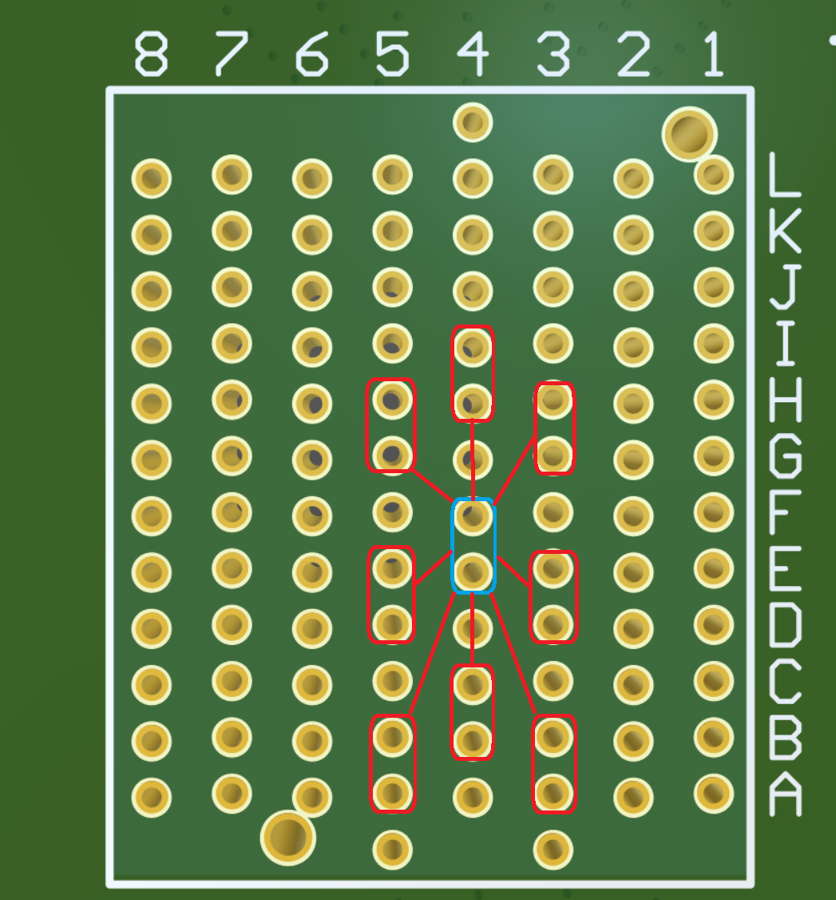
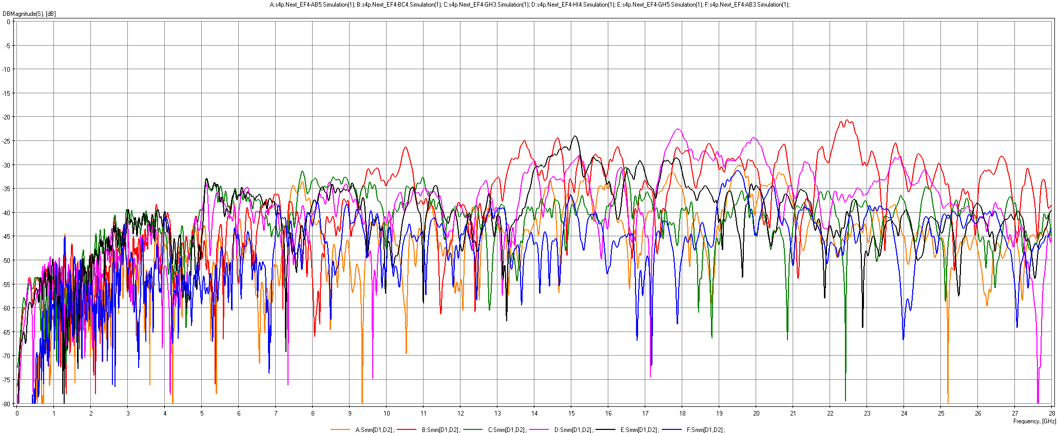
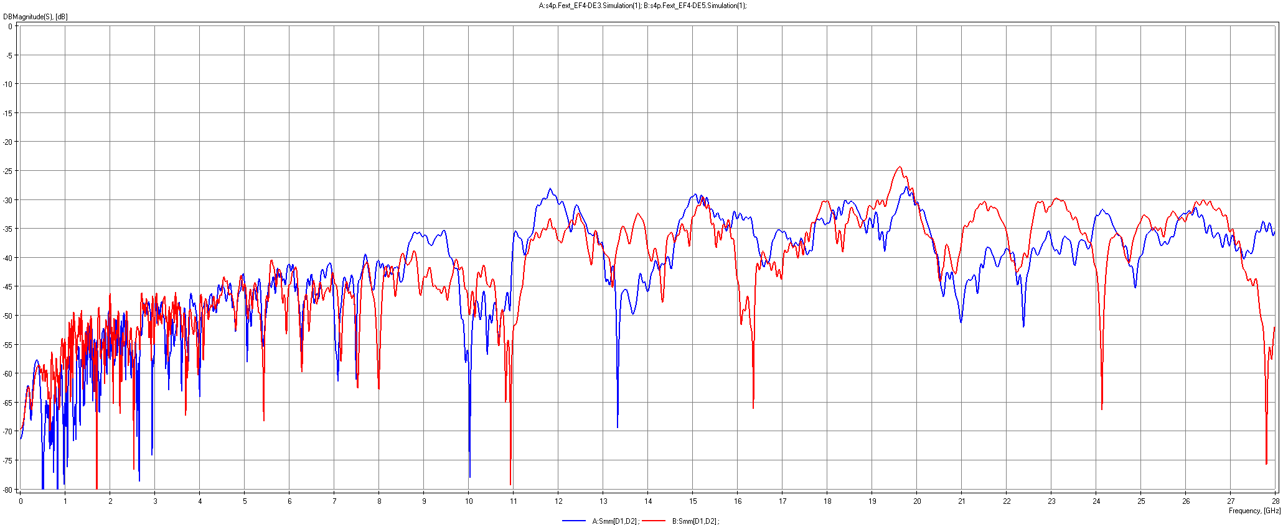
VALIDATION · HIGH DATA RATE
Crosstalk: NEXT and FEXT curves cluster tightly, with no outlier aggressor
NEXT on EF4 from six neighbours (dB vs GHz)
Victim EF4 (blue) and aggressors (red)
Symmetric field; no pair re-arrangement needed
Comparable to AirMax; dominated by the breakout region at high frequency
SPCD 2026 · HYPERBITS™ · Performance Interconnect SAS
16
Notes:
Lower plot is FEXT on EF4. The worst crosstalk at high frequency comes from the board breakout that is still in the measurement.

Slide 17
VALIDATION · HIGH DATA RATE
Insertion loss and crosstalk meet the requirement up to 12.5 Gb/s; crosstalk holds to 25 Gb/s
Parameter | Nyquist | NRZ rate | Measured min | Measured max | Limit | Status
Insertion loss | 3.12 GHz | 6.25 Gb/s | –0.4 dB | –0.8 dB | ≥ –1 dB | Meets
Insertion loss | 6.25 GHz | 12.5 Gb/s | –0.9 dB | –1.2 dB | ≥ –1.5 dB | Meets
NEXT | 3.12 GHz | 6.25 Gb/s | –58 dB | –40 dB | ≤ –39 dB | Meets
NEXT | 6.25 GHz | 12.5 Gb/s | –53 dB | –36 dB | ≤ –34 dB | Meets
NEXT | 12.5 GHz | 25 Gb/s | –50 dB | –33 dB | ≤ –29 dB | Meets
FEXT | 3.12 GHz | 6.25 Gb/s | –56 dB | –42 dB | ≤ –42 dB | Meets
FEXT | 6.25 GHz | 12.5 Gb/s | –57 dB | –43 dB | ≤ –34 dB | Meets
FEXT | 12.5 GHz | 25 Gb/s | –40 dB | –32 dB | ≤ –29 dB | Meets
Insertion loss | 12.5 GHz | 25 Gb/s | –3.1 dB | –8.9 dB | ≥ –2 dB | Next build
Diff. impedance | — | — | 89 Ω | 107 Ω | 95–105 Ω | Next build
8 of 8
loss and crosstalk checks met through the 12.5 Gb/s band, including all crosstalk checks at 25 Gb/s
2
items addressed in the next build: 25 Gb/s insertion loss and impedance window, both traced to the pin/transition region (next slide)
Measured values include the daughtercard and backplane breakout plus ≈2 mm of trace each side.
SPCD 2026 · HYPERBITS™ · Performance Interconnect SAS
17
Notes:
This is the data-rate answer. Insertion loss and both crosstalk terms meet the limits at 6.25 and 12.5 Gb/s, and crosstalk still meets at 25 Gb/s. The 25 Gb/s insertion loss and the impedance window are the two improvement items and they are located in the pin and transition region, not in the S-FECT termination.

Slide 18
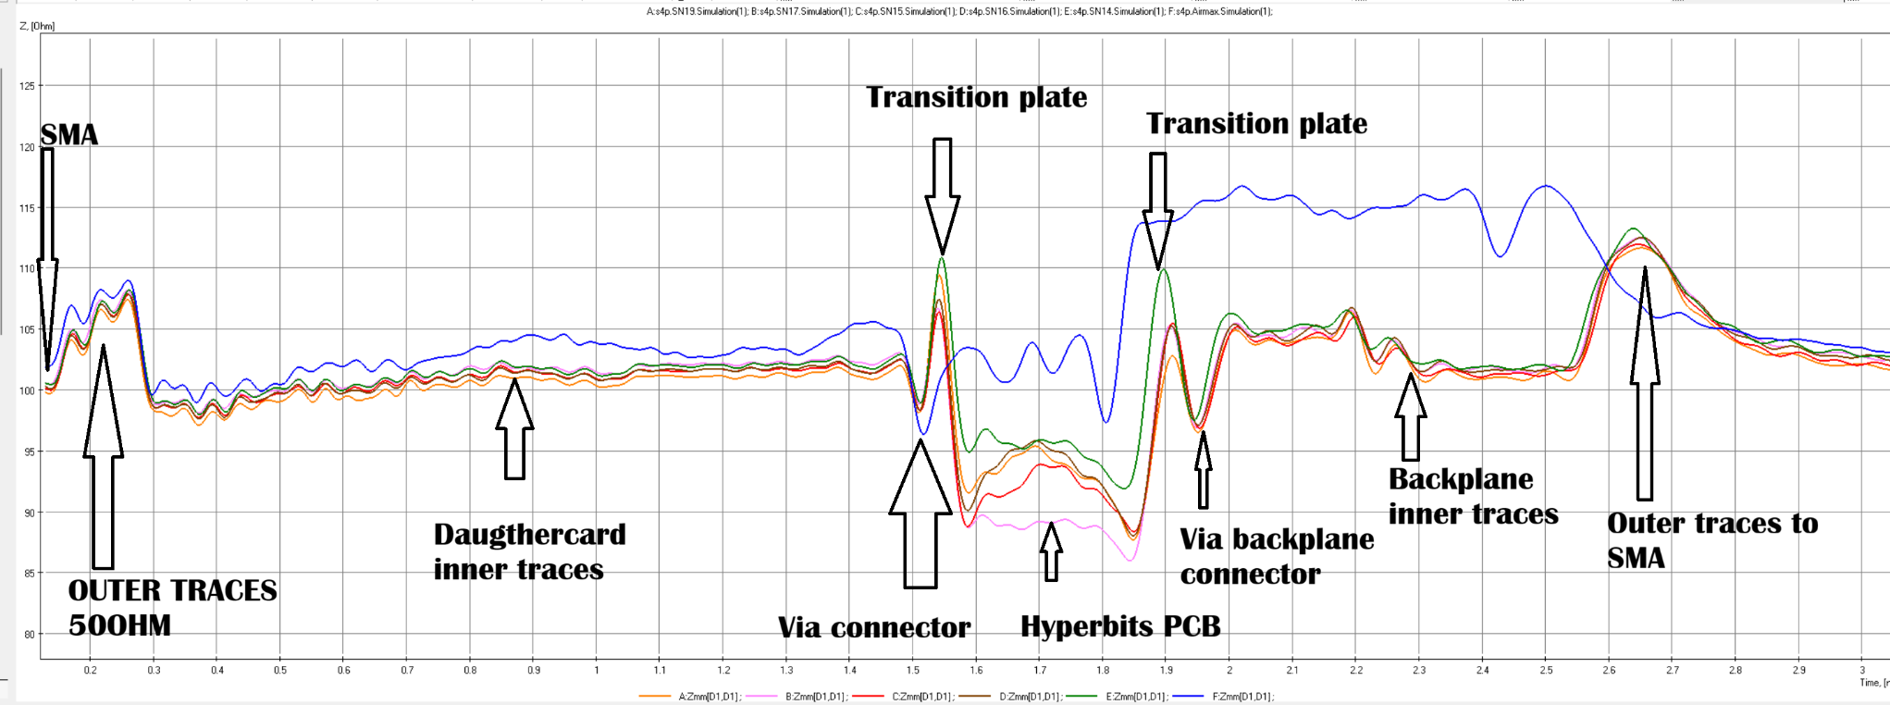
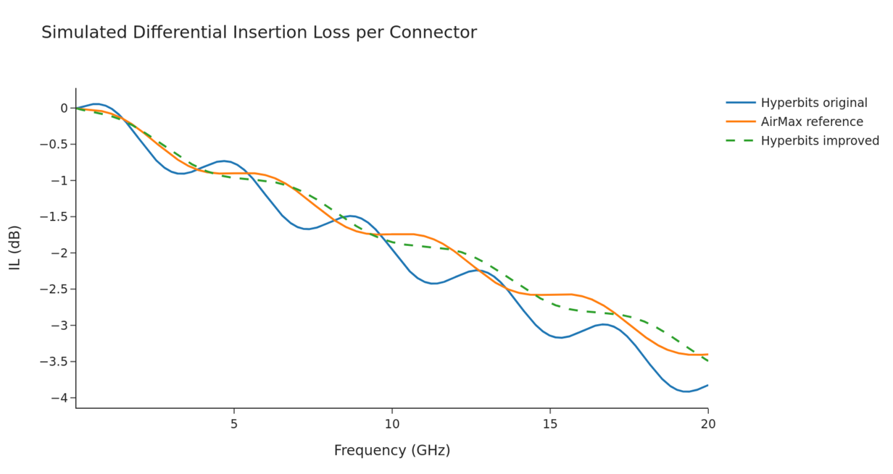
VALIDATION · HIGH DATA RATE
Remaining margin sits in the pin/transition region and internal PCB, not in the S‑FECT™ termination
Simulated IL: original, AirMax reference, improved (estimate)
Good impedance in daughtercard inner layer and connector vias
Bump at the pin/transition plate, slightly low Z in connector PCB
AirMax: slightly better IL/RL above ≈16 Gb/s; difference small
TDR, 32 ps rise time: five HYPERBITS™ samples and AirMax (blue)
Next-build changes
Connector PCB traces to 103 Ω ±5% to match the transition area
Higher-Dk alignment / transition plate; thicker pins in the transition
Larger anti-pads on the test-card connector vias
SPCD 2026 · HYPERBITS™ · Performance Interconnect SAS
18
Notes:
The TDR localises the issue. Daughtercard and vias are fine; the step is at the pin and transition plate and in the connector PCB. The fixes are layout and material changes, a small-tweaks regime rather than a redesign.

Slide 19
INDEPENDENT VERIFICATION
Alter Technology France summary
Olivier Perrotin, Alter Technology France
From the ARTES AT 5C.461 Test Readiness Review, 19 September 2026
19
Notes:
Handover to Olivier Perrotin, Alter Technology France.

Slide 20
ALTER TECHNOLOGY · TEST PLAN
ESA reliability assessment: 12 HDR and 10 power connectors across parallel test groups (requirement from ECSS-Q-70-61C)
Test sequence (TN4 chapter) | Parts
Vibration → Shock → Temperature cycling → Climatic sequence → Plating thickness | HDR 2×2 · Power 2
Rapid change of temperature (Thermal shocks air/air) → Endurance (100 times with back plane / 10 times with Daughter card) | HDR 2×2 · Power 2
Mating / unmating force → High-temperature storage / Life-test → Corrosion | HDR 2 · Power 2
High-temperature measurements + overload test for Power connector | HDR 2 · Power 2
Control group | HDR 2 · Power 2
Monitoring during vibration and shock
HDR: differential daisy-chain, 200 MHz clock pattern sampled at 6.4 Gb/s, any error detected
Power: two daisy-chains, contact disturbance threshold 5 ns
HDR gold plating variants: 0.2 µm and 1.27 µm
SPCD 2026 · HYPERBITS™ · Performance Interconnect SAS · Alter Technology France · TRR 19/09/2026
20
Notes:
Olivier: test flow from TN4. HDR 12 parts, power 10 parts. Electrical monitoring during vibration and shock is the part re-planned in September.

Slide 21
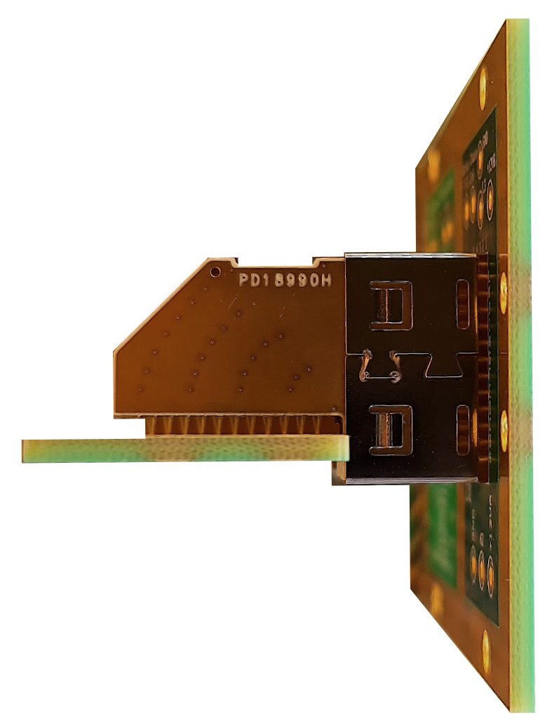
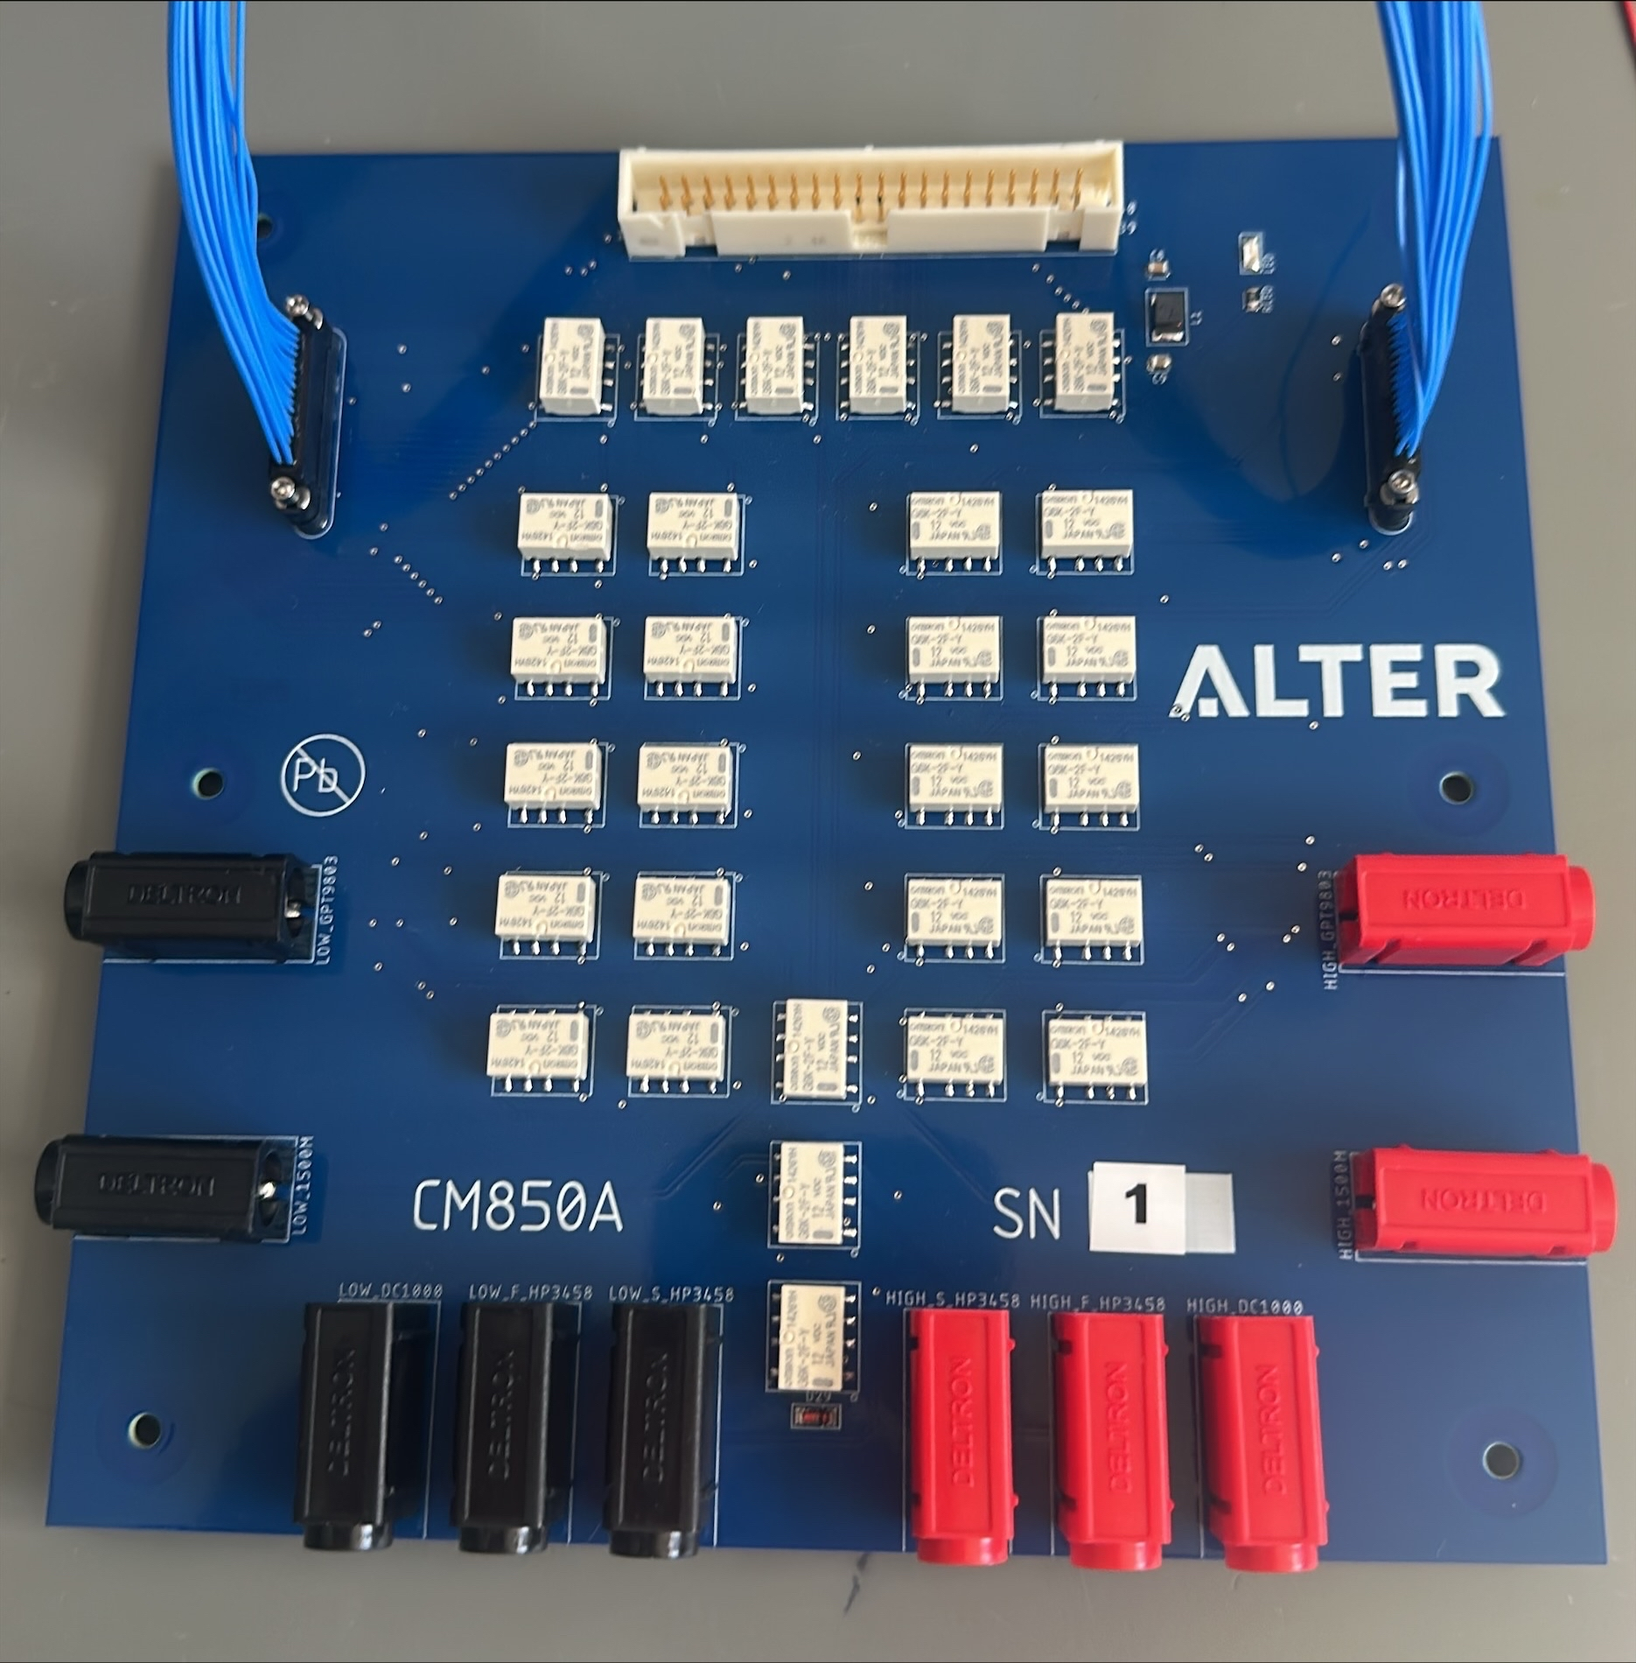
ALTER TECHNOLOGY · DC METHOD
DC resistance measured pad-to-pad through the full connector with 4-wire instrumentation
Measurement | Instrument
Contact resistance (Rcl, Rcr) | 8½-digit multimeter, 4-wire
Current-loaded resistance | Current source, up to 2 A per contact
Insulation resistance | DC megohmmeter, 500 Vdc
Voltage proof (DWV) | High-voltage dielectric meter, 750 Vrms
Five reference positions per connector (R1–R5) plus two daisy-chains per connector type.
Principle: probes on rear PCB traces
Alter test-board interface
SPCD 2026 · HYPERBITS™ · Performance Interconnect SAS · Alter Technology France · TRR 19/09/2026
21
Notes:
Olivier: measurement set-up and instruments.

Slide 22
ALTER TECHNOLOGY · DC RESULTS
Typical DC values: low contact resistance and tens-to-hundreds of GΩ insulation
HDR connectors | Mean
Daisy-chain 1 (32 lines – 64 contacts) | 657 mΩ
Daisy-chain 2 (32 lines – 64 contacts) | 673 mΩ
5 Contact resistances | 13 – 24 mΩ
Insulation resistance | 30 – 40 GΩ
Power connectors | Mean
Daisy-chain 1 (20 contacts) | 295 mΩ
Daisy-chain 2 (20 contacts) | 295 mΩ
Contact R1–R5, low/rated | 7 – 22 / 7 – 25 mΩ
Insulation resistance | 110 – 270 GΩ
7 mΩ
13–24 mΩ
750 Vrms
lowest power-connector contact reading
HDR contact range, card to backplane
voltage proof applied, IR at 500 Vdc
IR / DWV chains: each daisy-chain against the other chain + GND, and GND against both chains.
SPCD 2026 · HYPERBITS™ · Performance Interconnect SAS · Alter Technology France · TRR 19/09/2026
22
Notes:
Olivier: typical DC values. Power daisy-chain about 295 mOhm versus about 660 mOhm for HDR; power contacts from 7 mOhm.

Slide 23
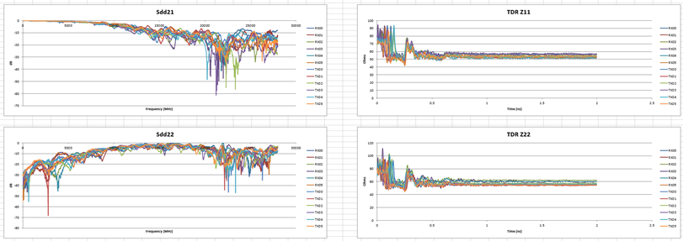
ALTER TECHNOLOGY · HDR VERIFICATION
HDR 8-row RF check: consistent Sdd21/Sdd22 and flat TDR across all 12 differential lines
15
HDR 8-row connectors manufactured and DC-inspected for the campaign
+8 units supplied to OHB, +3 set-up units to Performance Interconnect
Representative part: Sdd21 and Sdd22 (left), TDR Z11 and Z22 (right), RX00–RX05 and TX00–TX05
Twelve differential lines per connector measured on the Alter HDR test board
Transmission and reflection consistent line to line
TDR flat through the connector after the launch region
SPCD 2026 · HYPERBITS™ · Performance Interconnect SAS · Alter Technology France · TRR 19/09/2026
23
Notes:
Olivier: HDR verification on the Alter board, a representative part.

Slide 24
CONCLUSIONS
Concept proven, design validated, data-monitored S&V next
Resistance
Data rate
Robustness
Next
7–25 mΩ card-to-backplane on all 96 HDR positions
Power connector: planes in parallel, contacts from 7 mΩ
Below the mating interface alone of press-fit systems
IL and crosstalk meet the requirement through 12.5 Gb/s
Crosstalk still meets at 25 Gb/s
Small unit-to-unit spread across 5 samples
Sine 20 g to 2 kHz and 50 g shock, 3 axes, no event
Stable mating forces over cycles
IR 30–270 GΩ, 750 Vrms proof
S&V with live data per the updated requirement
103 Ω ±5% connector PCB and transition-plate update
Remaining ESA reliability sub-groups
HYPERBITS™ with S‑FECT™: a European single-body HDR connector ready for ADHA qualification.
SPCD 2026 · HYPERBITS™ · Performance Interconnect SAS
24
Notes:
Summarise the three proofs, then the next steps.

Slide 25
and now:
a live, blind-mating demonstration!
For questions or to request more information contact:
Gaby Cristian Mindreci
PERFORMANCE INTERCONNECT SAS
www.pisas.fr
Olivier Perrotin
Alter Technology France
www.altertechnology.fr

